Slide 1

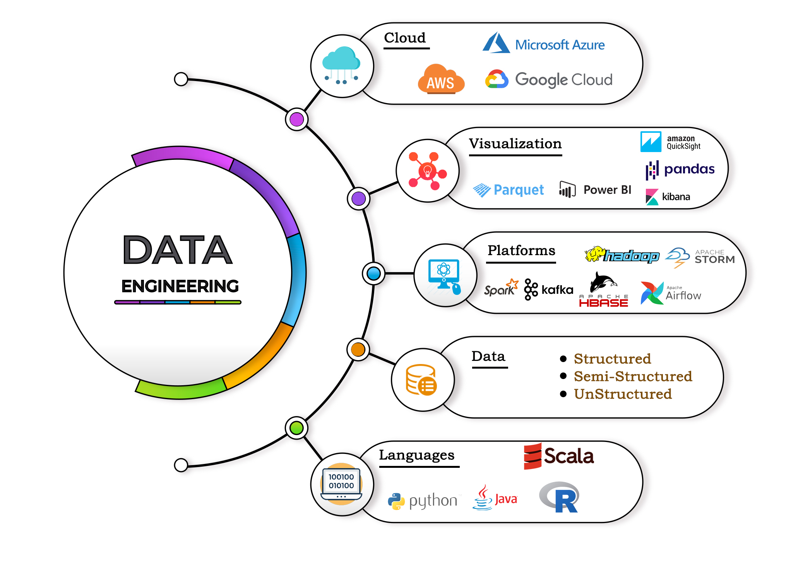
Olympics Data
Engineering Project
Team 1 - Speculative Execution
Team Members:
P. Nithin
Siddhesh
Prajaktha
Jay Jathar
Jachinn Paul

Slide 2
Objective
Ingest Olympic Games data from sources into your data ecosystem and transform it for efficient storage and analysis.
Enable data analysis and reporting capabilities to derive insights from Olympic Games data.
Ensure data security and compliance with relevant regulations and standards.

Slide 3





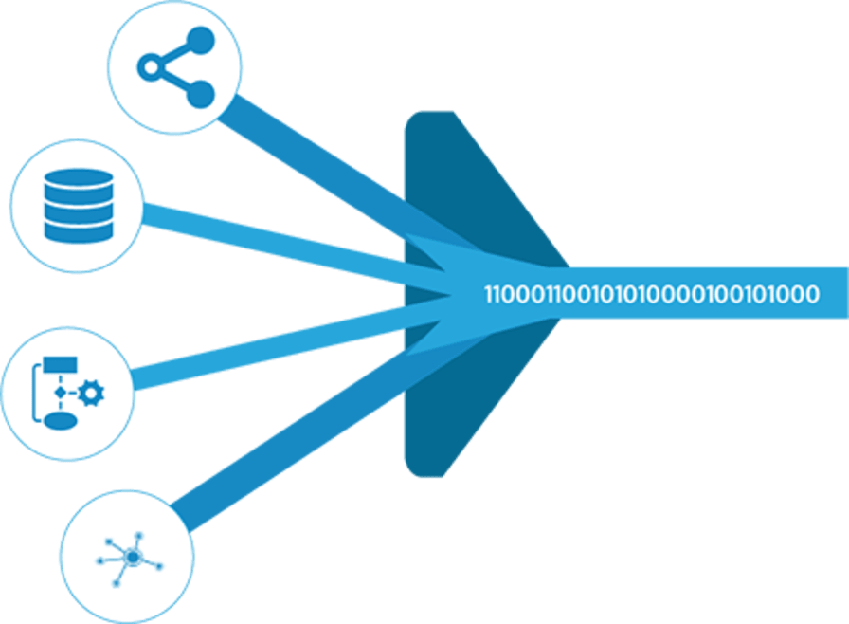





OLYMPIC DE SOLUTION ARCHITECTURE
SOURCE
INGESTION/
ETL
STORAGE/
ANALYSIS
BI
P1
P1
P1
P2
P2
P3
P2
P3
P3
P4
P4
P4

Slide 4
Stage 1: Source
MySQL
Amazon S3
Azure Blob
Open-source database management system with a relational database and an SQL server
Scalable object storage service for securing and managing data storage
Data storage facility designed for multimedia files with data encryption measures

Slide 5
Stage 2: Ingestion / ETL
Sqoop
Copy-into
Snowflake Snow Pipe
Provides a command-line solution for transferring data between Hadoop and relational databases. Great for integrating big data analytics with existing data storage.
An effective way to copy data from files hosted on cloud storages and databases, enabling easy data ingestion.
Automated ingestion service, facilitating data transfer from cloud data sets to Snowflake and then to the cloud again.

Slide 6
Stage 3: Storage / Analysis
Hive
Apache HBase
Snowflake
Data warehousing software for big data analysis and processing in real-time. Provides SQL-like capabilities.
A NoSQL database, horizontally distributed and scalable for large datasets. Best for supporting real-time processing of data.
A cloud-based data management system, providing data warehousing, devoid of configuration and administration. Great for instant and secure analysis of multiple data types.

Slide 7
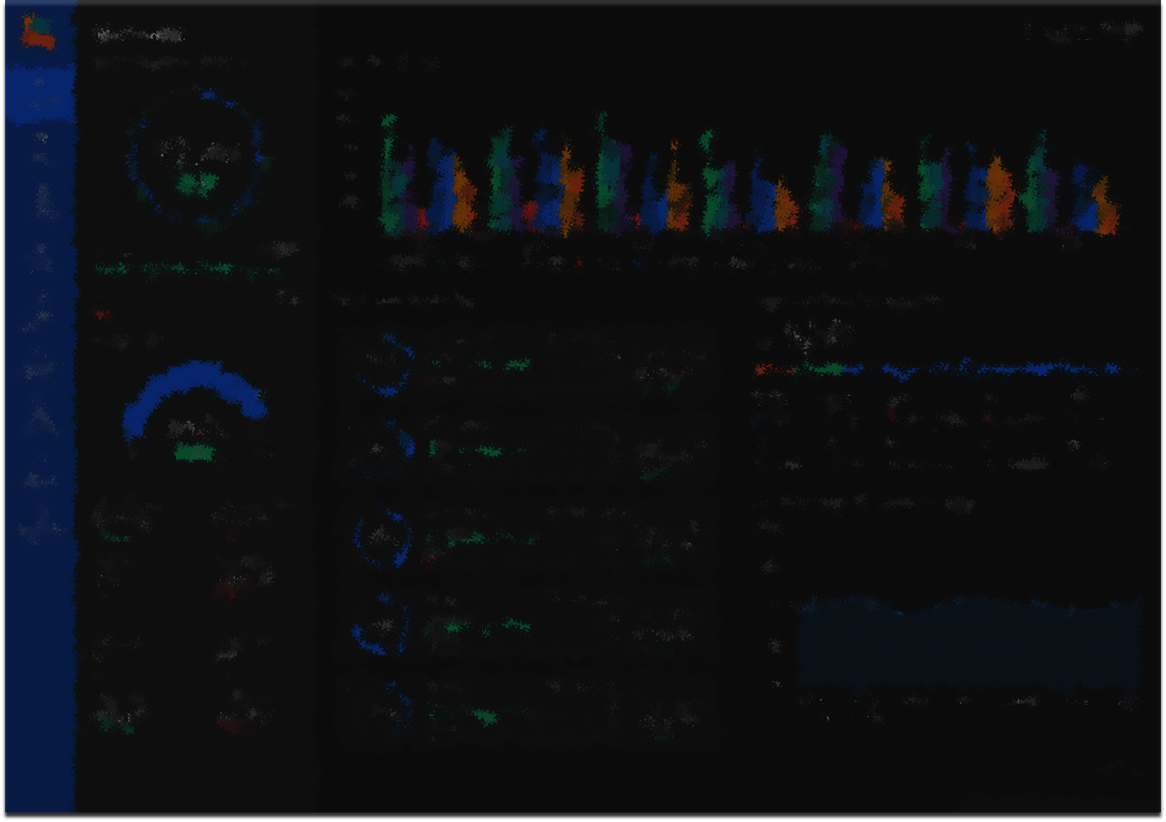

Stage 4: BI
Power BI
Microsoft Power BI is a business intelligence-focused software product created by Microsoft, specializing in interactive data visualization. It forms an integral part of the Microsoft Power Platform.

Slide 8
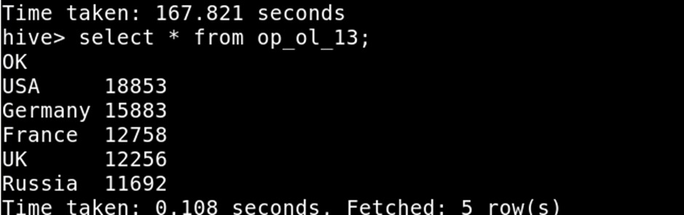
Hive User Story
Fetch the top 5 most successful countries in olympics. Success is defined by no of medals won.
select nr.region, count(oh.medal) as medalsWon
from olympics_history oh
join olympics_history_noc_regions nr on oh.noc = nr.noc
group by nr.regionorder by medalsWon desc limit 5;

Slide 9
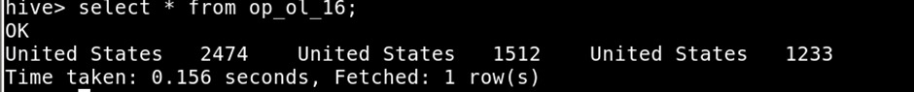
Hive User Story
Identify which country won the most gold, most silver and most bronze medals in each olympic games.
select * from (select team as most_gold_country,count(*) as Gold_count from olympics_history_optimized where medal='Gold' group by team order by Gold_count desc limit 1) as cte join (select team as most_silver_country,count(*) as Silver_count from olympics_history_optimized where medal='Silver' group by team order by Silver_count desc limit 1) cte2 join (select team as most_bronze_country,count(*) as Bronze_count from olympics_history_optimized where medal='Bronze' group by team order by Bronze_count desc limit 1) cte3 ;

Slide 10
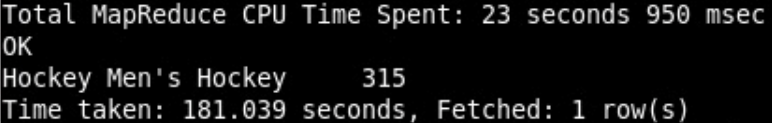
HBase User Story
In which Sport/event, India has won highest medals
select event,count(medal) as total_medals
from olympics_history_integrated
where noc like 'IND’
group by event
order by total_medals desc
limit 1;

Slide 11
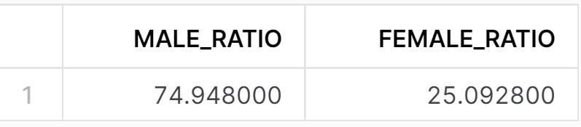
Snowflake User Story
Find the Ratio of male and female athletes participated in all olympic games.
with cte as (
select distinct name, sex
from olympics_history)select sum(case when sex = 'M' then 1 else 0 end)/(select count(distinct name) from olympics_history)*100 as male_ratio, sum(case when sex = 'F' then 1 else 0 end)/(select count(distinct name) from olympics_history)*100 as female_ratio
from cte;

Slide 12
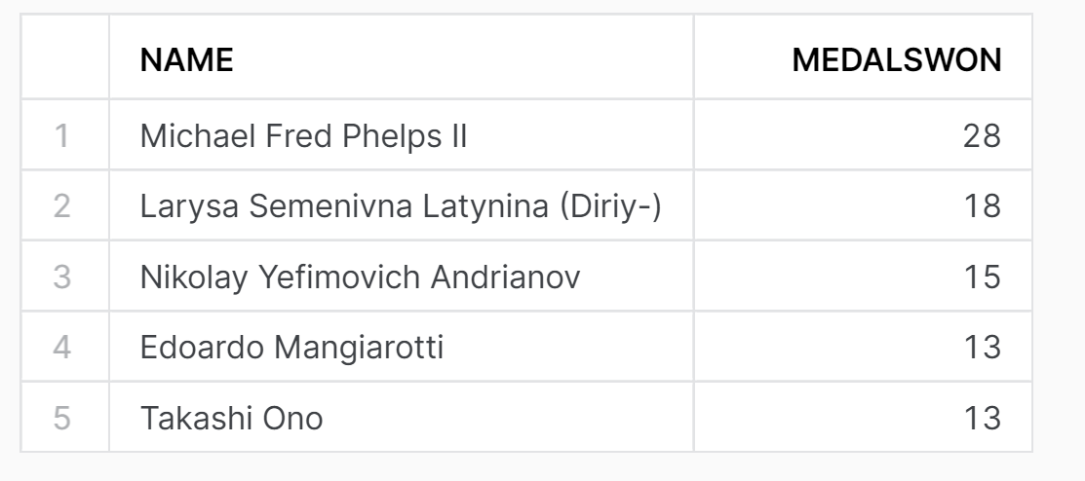
Snowflake User Story
Fetch the top 5 athletes who have won the most medals (gold/silver/bronze)
select name, count(medal) as medalsWon
from olympics_history
group by name
order by medalsWon desc
limit 5;

Slide 13
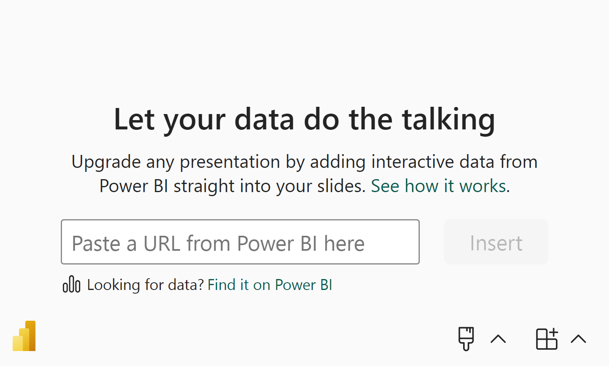
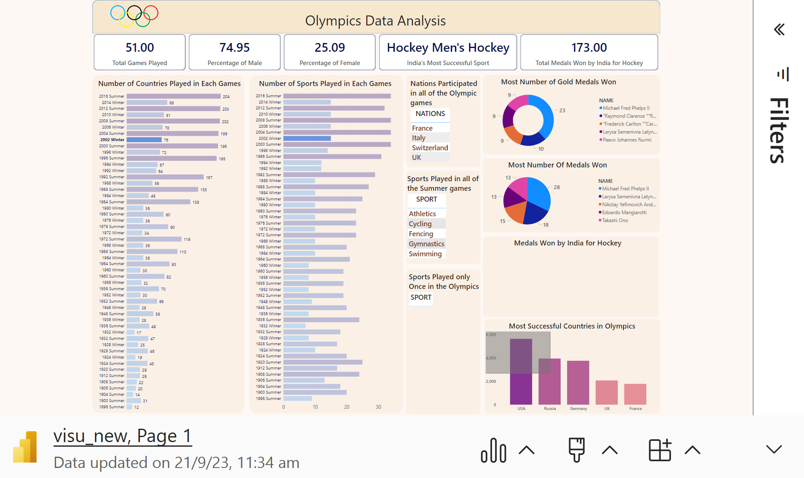

Slide 14

Challenges
Timeline Pressure
Data Quality
Data Integration
Zookeeper

Slide 15

Conclusion
The right data engineering solution architecture is critical for companies looking to make the most of their data. In this presentation, we've explored different stages and components of this architecture, including the source, ingestion, storage, analysis, and BI components. By combining these components cleverly, you can improve your data processing and delivery for better business insight.

Slide 16

Thank you sir
Venkata Satya Billa
-DE Expert

